Slide 1

Guidelines
Kindly use the given template for submitting your project (Make a copy of the template)
One team is only required to submit one project.
The ideal size of the presentation should not be more than 10 slides.
You are welcome to add as many POCs and design concepts to support your project.
The project should be feasible and the team members should be capable enough, to come up with the prototype of the same idea, if required.
Projects using Google developer technologies like Gemini APIs & building projects on IDX platform will earn additional points.
In case of queries, kindly reach out to us at solutionchallengesupport@hack2skill.com

Slide 2
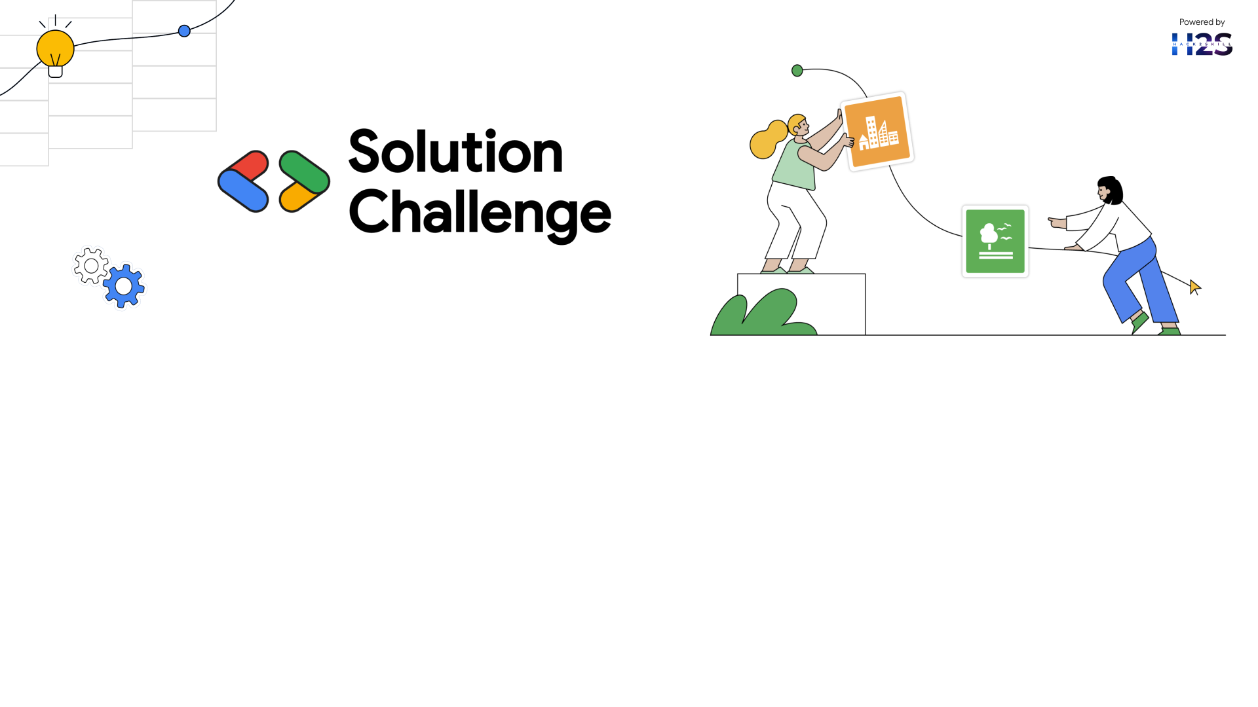
Team Details
Localhost:3000
Thanus Kumaar A
Open Innovation for a better tomorrow

Slide 3
SustAIn
As AI usage continues to rise - especially in the form of large language models and generative tools - users remain unaware of the hidden environmental cost associated with their queries. SustAIn addresses this gap through a simple yet powerful solution.
SustAIn is a Chrome extension that tracks and displays the estimated energy, carbon emissions, and water consumption of AI queries made by users on popular platforms. The extension uses well-established research, formulas, and a query classification AI model hosted on Vertex AI to calculate these sustainability metrics in real-time.
By providing transparent, accessible insights directly in the user's browser, SustAIn empowers individuals and organizations to become more mindful of their AI usage and make environmentally informed decisions.

Slide 4
How different is it from any of the other existing ideas?
While several tools exist to track carbon footprints in general cloud services, SustAIn stands out as the first browser-based solution focused specifically on the sustainability of AI usage.
Unlike platforms that assess full-scale infrastructure emissions, our lightweight Chrome extension provides real-time feedback at the query level, focusing on generative AI tools like ChatGPT, Gemini, and others. There are no existing extensions that track or visualize the environmental impact of AI queries for end-users in this focused, accessible way.
How will it be able to solve the problem?
SustAIn solves the awareness gap in AI's environmental cost by making sustainability metrics visible, relatable, and real-time. It uses research-backed estimates and contextual comparisons (like energy used vs. household appliances or water used vs. bottles) to help users understand the consequences of their AI usage.
By embedding this insight directly in their browsing experience, users are empowered to make conscious choices, potentially reducing unnecessary or excessive AI interactions and promoting more sustainable habits.
USP of the proposed solution
First-of-its-kind Chrome Extension providing sustainability insights specifically for AI and LLM usage.
Real-time environmental metrics (energy, water, CO₂) shown for individual AI queries.
Backed by proven methodologies using data simulations, open APIs, and published research.
Non-intrusive and easy to adopt—no need for backend integration or platform-level access.
Scalable and embeddable, allowing businesses to integrate the sustainability widget into their own dashboards or apps.

Slide 5
List of features offered by the solution

Slide 6
Process flow diagram or Use-case diagram

Slide 7
Wireframes/Mock diagrams of the proposed solution (optional)

Slide 8
Architecture diagram of the proposed solution

Slide 9
Technologies to be used in the solution
(Additional points for those who are:
Building their project on IDX
Integrating Gemini APIs)

Slide 10
Estimated implementation cost (optional)

Slide 11
Snapshots of the MVP

Slide 12
Additional Details/Future Development (if any)

Slide 13
Provide links to your:
GitHub Public Repository
Demo Video Link (3 Minutes)
MVP Link

Slide 15
